Slide 1
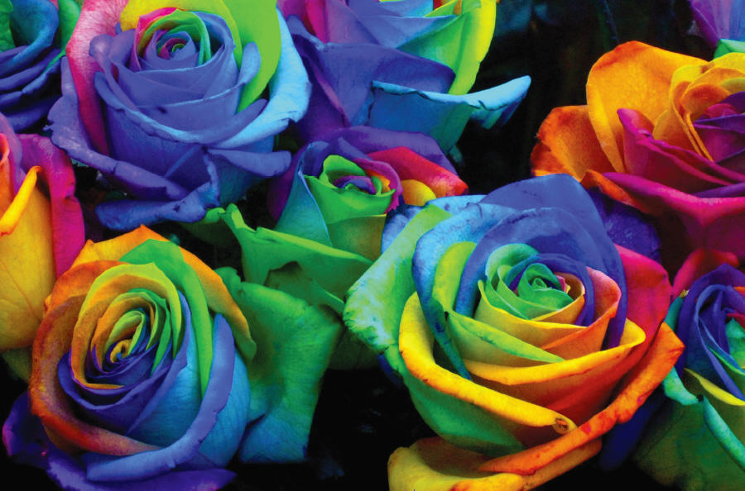
Chapter 5
Color in Digital Media
© 2013 Cengage Learning. All Rights Reserved. May not be scanned, copied or duplicated, or posted to a publicly accessible website, in whole or in part.

Slide 2
Lessons
Lesson 5.1: Understanding RGB, CMYK, and HSB
Lesson 5.2: Recognizing Color Theory Terms and Concepts
Lesson 5.3: Using Color Matching Systems

Slide 3
Learning Outcomes
5.1: Understand the difference between RGB, CMYK, and HSB color models
5.2: Specify the appropriate color mode based on output
5.3: Become familiar with basic color terminology
5.4: Identify and use basic color theory to choose colors
5.5: Recognize the advantages of color matching systems

Slide 4
The RGB Color Model
A color model is a group of colors identified in a way that computers can understand
Primary colors are basic colors that cannot be created by mixing other colors
Mixing two primary colors creates a secondary color
Combining three different colors of light at different intensities to produce a whole range of other colors is called additive color mixing
The RGB color model uses red, green, and blue primary colors plus different intensities of light to create colors on an electronic display like a computer screen

Slide 5
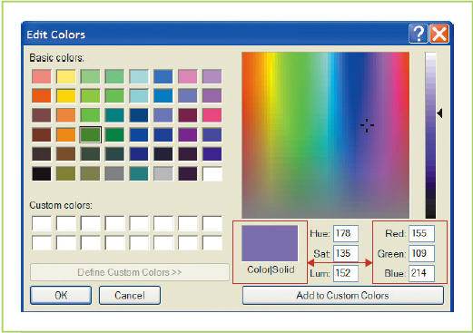
The RGB Color Model (continued)
The RGB triplet is the combination of numbers indicating light intensity for the red, green, and blue primary colors in the RGB color model and representing a certain color within the model

Slide 6
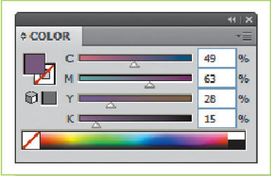
The CMYK Color Model
Subtractive color mixing is mixing primary pigment colors to absorb different amounts of light and create a range of colors
The CMYK color model is based on cyan, magenta, yellow, and black pigments which are used to create full color on printed materials

Slide 7
HSB, HSL, and HSV Color Models
HSB color model is a color model based on human perception of color that uses hue, saturation, and brightness to define a color
Hue refers to the general color expressed by a value between 0 and 360 degrees
Saturation refers to the intensity of a hue on a scale from 0 to 100%
Brightness is the measure of how light or dark a color is on a scale of 0 to 100%

Slide 8
Selecting the Appropriate Color Model
Use RGB for projects that will be viewed on an electronic screen such as a Web site, a slideshow presentation, or a video
Use CMYK for any project that is destined to be printed on a commercial press, like a book, a magazine, a poster, or a brochure
The range of colors that a color model can produce is called a gamut
Out of gamut refers to colors that are part of the range of one color model but not another
The color mode is a way to indicate to a computer what color model to use when representing colors

Slide 9
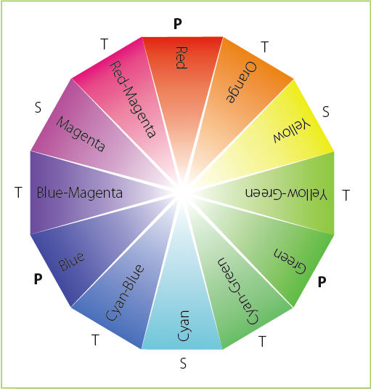
The Color Wheel and Basic Color Terminology
The color wheel is a visual representation of primary, secondary, and tertiary colors that can be useful for understanding and using basic concepts in color theory
The tertiary color is the color created when a primary and a secondary color are mixed
Megan Smith-Creed

Slide 10
The Color Wheel and Basic Color Terminology (continued)
Hue is basically just another word for color and you can use the terms interchangeably
Black, white, and gray are not hues in color theory; they are neutral colors
Neutrals are mixed with hues to change the nature of a color
A hue mixed with black creates a shade of that color
A hue mixed with white produces a tint of that color
When gray is mixed with a hue, the result is a tone of that color
A range of grays is called grayscale

Slide 11
The Color Wheel and Basic Color Terminology (continued)
Hues opposite each other on the color wheel are called complementary colors
In the RGB model, blue and yellow are complementary colors
Hues next to each other on a color wheel are called analogous colors
In the RGB model, red and orange are analogous colors

Slide 12
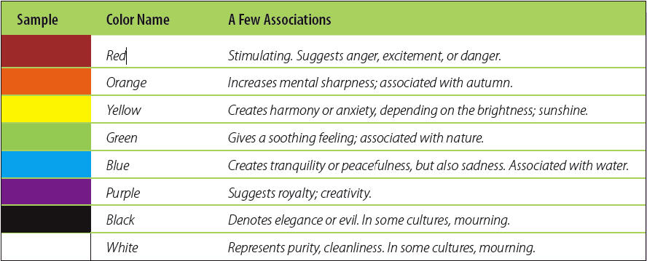
Color and Its Meaning
Colors can produce different impressions
Can vary based on age, gender, culture, and personal experience

Slide 13
Color Preferences
How do you respond to color?
Are you more likely to buy a product because it is a certain color?
Does the background color of a Web site make it more interesting?
What makes you choose one color over another?

Slide 14
Color Themes
A color theme is a combination of different hues that work together to create color harmony
Color harmony is a cohesive and pleasing combination created by a group of colors
Monochromatic Color Theme
Includes a single color combined with shades and tints of that color
The most subdued color theme and doesn’t offer a lot of contrast in a design
Is easy to create and can make designs look elegant and calm

Slide 15
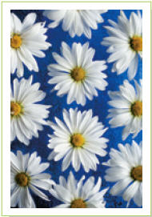
Color Themes (continued)
Complementary Color Theme
Includes two colors that sit directly across from one another on a color wheel
To make a design more interesting, you can expand a complementary color theme by using different shades, tints, and tones of the two complementary colors in the theme
The contrast between complementary colors makes these themes vibrant and gives a sense of excitement to a design
Work best if you choose one main color and use the other color for smaller details
Jaren Jal Wicklund/Shutterstock.com

Slide 16
Color Themes (continued)
Analogous Color Theme
Includes colors that are next to one another on a color wheel
Create a sense of calm and unity
Triadic Color Theme
Includes three evenly separated hues from a color wheel
Have a lot of contrast and energy
Color Theme Tools
You can automatically generate color themes using online tools
Adobe Kuler is a color tool you can use to automatically generate a color theme by selecting a base color and then selecting a color rule such as complementary or triadic

Slide 17
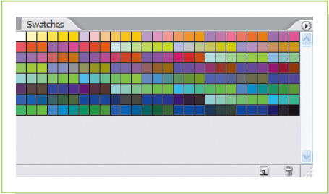
Web-Safe Colors
Web-safe colors are the 216 colors that all users can see, regardless of their computer displays
Because computer video cards are more powerful and displays using true color (32 bit) or high color (24 bit) are more common, the use of “safe” colors is less of a concern

Slide 18
Pantone Matching System
In certain situations, it is important that the color on the printed material matches exactly what the designer intended
Standardized color systems and associated ink formulations have been developed to identify and label specific colors in the design and printing industry; these are called spot colors
The most widely known color matching system is the Pantone Matching System (PMS color)
Use a printed PMS swatch book to choose your colors
Because a printer has to add a specific plate to print spot color, it can be expensive

Slide 19
De-Stressing
If you get too stressed over your job, your work can suffer—which in turn will simply increase your anxiety
It is possible to take your work seriously but not become overly stressed about it.
When you feel overburdened, try a few simple tactics to relieve the pressure:
Keep your sense of humor
Take a coffee break with a coworker
Go for a walk
Listen to music
Try to stay focused and use your time wisely
Make sure to eat right and exercise daily; good nutrition and physical fitness are great stress-busters
What do you do to relieve stress?

Slide 20
Key Concepts
The RGB color model uses red, green, and blue and different intensities of light to create a range of colors. It’s used to show color on an electronic display
The CMYK color model uses cyan, magenta, yellow, and black pigments to create a range of colors. CMYK is used to reproduce colors on printed materials
HSB is a color model based on human perception of color (hue, saturation, and brightness). It is used to make adjusting colors easier and can be used in either RGB or CMYK mode
The color mode tells the computer which color model data to use to represent colors
The two main color modes are RGB and CMYK. You use RGB mode for projects that will be viewed on a screen and CMYK mode for files that will be printed

Slide 21
Key Concepts (continued)
Using a color wheel and understanding concepts like complementary and analogous colors as well as terms like shade, tint, and tone can help you recognize and use color theory in your projects
You can use different colors to set different moods in your projects
Using color themes like monochromatic, complementary, analogous, and triadic can create color harmony in your projects
Color matching systems like Web-safe colors and PMS make it easier to accurately reproduce colors no matter where they are viewed or where they are printed

