Slide 1
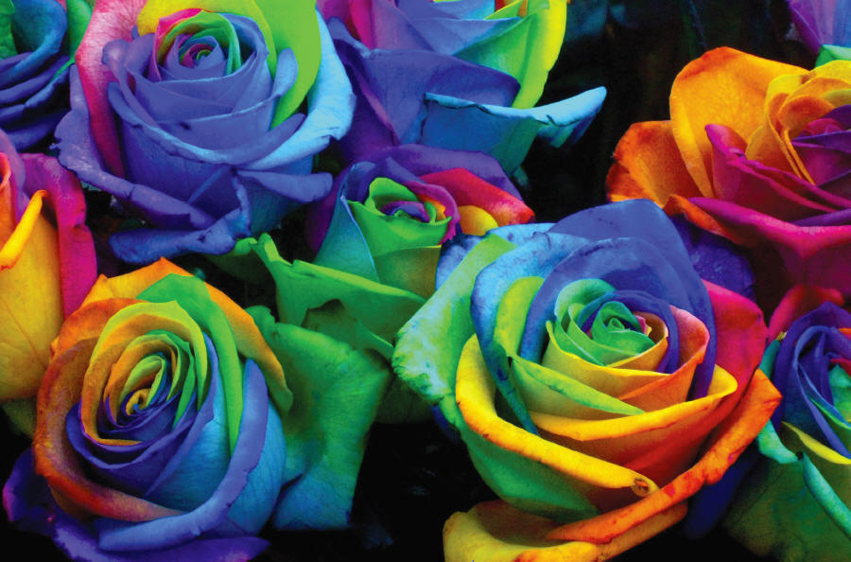
Chapter 3
Image Files
© 2013 Cengage Learning. All Rights Reserved. May not be scanned, copied or duplicated, or posted to a publicly accessible website, in whole or in part.

Slide 2
Lessons
Lesson 3.1: Distinguishing Between Graphic Programs
Lesson 3.2: Determining Image File Formats
Lesson 3.3: Managing Image Sizes

Slide 3
Learning Outcomes
3.1: Convey the difference between painting and drawing programs
3.2: Demonstrate an understanding of file extensions and file types
3.3: Recognize the role that compression, interlacing, encoding, and resolution play in file sizes

Slide 4
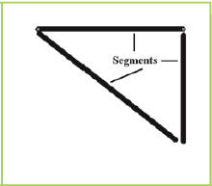
Distinguishing Between Graphic Programs
Paint programs create images by using pixels (or picture elements)
A pixel is a specific color at a specific location in a matrix or grid. A collection of pixels produces an image on a computer screen or on a printed page.
Drawing programs use vectors, or lines, to produce an image

Slide 5
Raster-Based Paint Programs
Paint programs create images by assigning each pixel to a point on a grid of x and y coordinates called a raster
Images created using this grid are referred to as raster images, raster graphics, or bitmaps
Enlarging raster images can result in pixelation, or jaggies
Reducing images can produce images that lose sharpness

Slide 6
Raster-Based Paint Programs
Many software programs are available to create and manage raster images
The most widely used program in the professional world is Adobe Photoshop
Microsoft Paint is provided with the operating system
Corel Paint Shop Pro is a stand-alone program
GIMP (GNU Image Management Program) is open source
Cloud computing offers access to imaging software through the Internet (i.e., Picasa and Flickr)

Slide 7
Non-native Raster File Types
File Type | Information
BMP (bitmap) | Usually placed in word processing documents File sizes are often quite large Usually limited to 256 colors because they are created without using any compression
JPG (Joint Photographic Experts Group) | Use up to 16 million colors Reproduce the quality, color, and detail found in photographs or graphics using blends and gradients Most digital cameras save photographs as JPGs JPGs are the most common non-native raster file format in use today
GIF (Graphics Interchange Format) | Compressed and use only 256 colors File sizes are quite small Suitable for line drawings, images with transparent backgrounds, and animated figures Small and work on many platforms Are commonly used in Web page design

Slide 8
Non-native Raster File Types (continued)
File Type | Information
TIF (Tagged Image File Format) | A bitmap file type that works well in all environments Files are quite large Can show 16 million colors Are often used in print documents. Some digital cameras can save photographs in TIFF format
PNG (Portable Network Graphics) | Retains 16 million colors and supports transparency Is becoming more common Often used to replace GIF files partly because of the increase in available colors while remaining a small file size

Slide 9
Non-native Vector File Types
The most common native vector file format is AI (from Adobe Illustrator)
These file may be converted to a PDF, EPS, or SVG depending upon the intended output
File Type | Information
EPS Encapsulated PostSript | A general purpose vector file format that has both the vector image data and a screen preview in the same file Most commonly used for printing purposes
SVG Scalable Vector Graphics | SVG software is an example of an open source image A vector graphic format designed specifically for use on the Web Created using HTML code A popular choice for mobile devices because of its small file size

Slide 10
Licensing Fees
In 1994, CompuServe, the developer of the GIF file format, caused a stir when it announced its intention to require that all commercial software companies using GIF compression in their programs pay licensing fees
Was CompuServe correct in its decision to charge a licensing fee?
Why or why not?

Slide 11
Format Conversion
Once a copy of an image has been saved in its native format, you can change to another file format
Different file formats are appropriate for different situations
Some programs can import only graphics with specific file formats
Some images look better saved as one format rather than another
Some images need to be small in order to load quickly on the Internet

Slide 12
Compression
Bandwidth is the speed at which a computer can transmit information along a network
Compression is the process of reducing the size of the image
Lossy compression reduces the size of an image file by removing information that is not essential
Lossless compression does not change any pixel data

Slide 13
Compression (continued)
The .jpg file format uses lossy compression
Lossy compression deletes or changes some pixels when saving
When you save a file as a JPG, you select an image quality ranked from 1 to 12
A higher number means a higher quality image and a larger file size
A lower number means a lower quality image and a smaller file size

Slide 14
Resolution
Bitmap images have visual sizes measured in two ways
The physical size (such as a photograph printed as a 4 × 6-inch image)
The number of pixels in each inch
Physical sizes are also measured in pixel dimension (the number of pixels in a row and column of a raster grid)
The resolution of an image is measured in pixel density or pixels per inch (ppi)

Slide 15
Resolution (continued)
Image software allows you to manipulate images by changing the physical size as well as the pixel density
Physical size and pixel density work in tandem to determine your final product

Slide 16
Resampling
If you enlarge an image, you must either make the pixels bigger or add pixels
Resampling is adding or deleting image pixels during the process of resizing
Special formulas are used to determine what colors each new pixel should be based upon the colors around it

Slide 17
Resizing
Aspect ratio is the ratio of the width to the height of an image
If you change one number without changing the other, you will get a distorted image
Image software sometimes allows you to lock the aspect ratio

Slide 18
Key Concepts
Image programs can be categorized into two groups: paint programs and drawing programs
Paint programs produce images using pixels. Each pixel consists of a specific color. Images produced by paint programs are called raster images or bitmapped images
Drawing programs use vectors or lines to produce an image. The vectors are created using a series of mathematical points. Images produced by drawing programs are called vector images
Extensions for the most common raster file types are .bmp, .tif, .gif, .jpg, and .png

Slide 19
Key Concepts (continued)
Extensions for the file formats that are typically used for the Web are .gif, .jpg, and .png
Extensions for the most common vector file formats are .svg and .eps
Different file formats are appropriate for different situations.
JPG image file sizes are reduced using a lossy compression algorithm that removes unnecessary pixels. GIF, PNG, and TIF use a lossless compression
Resolution and pixel density help determine the size of a file
Resizing is best done maintaining the aspect ratio

