Slide 1
Chapter 19
Presentation Design
© 2013 Cengage Learning. All Rights Reserved. May not be scanned, copied or duplicated, or posted to a publicly accessible website, in whole or in part.

Slide 2
Lessons
Lesson 19.1 Templates
Lesson 19.2 Slide Layouts
Lesson 19.3 Text on Slides
Lesson 19.4 Visual Effects

Slide 3
Learning Outcomes
19.1 Use pre-defined templates
19.2 Incorporate layout elements and options, such as Slide Master settings, color choices, color schemes, and backgrounds
19.3 Understand the importance of text styling in a presentation
19.4 Enhance a message using visual effects

Slide 4
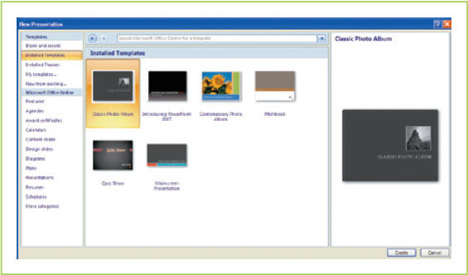
Templates
A template is a document master pre-designed by professionals who have already chosen the background, font size and color, and bullets to be used

Slide 5
Professional Templates
A disadvantage of using a template is that your audience may recognize the template from a previous experience
Use a template as a base for your design and then modify or personalize it for your presentation
Use third-party designs such as Digital Juice
Professional template designs include interesting backgrounds, animations, and photos

Slide 6
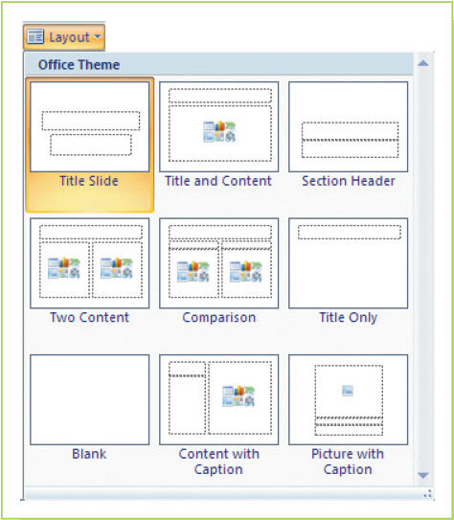
Basic Slide Layouts
Slide layouts (the arrangement of design elements on a slide) fall into three basic categories:
Title slide
Text slide with bullets
Multimedia slide
Table
Chart
Clip art
Picture
Diagram
Media (includes sound, video, or movies. In other environments, media may include any use of graphical or auditory additions to a presentation, such as a chart or graph)

Slide 7
Slide Master
A Slide Master is a single slide that can be designed once and then applied to many slides; PowerPoint allows the creation of multiple masters for use in different situations
Make design choices that apply to all slides
Choose the font size and style, background, and bullet choices
Includes header and footer information
Slide Masters provide consistent elements that will automatically appear on each new slide you create

Slide 8
Slide Master (continued)
In a Slide Master, you can set features, such as font style and color, across all slides in a presentation

Slide 9
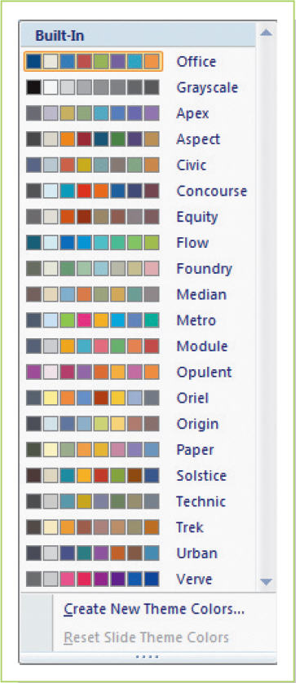
Color Choices
Color in a presentation can:
Increase learning retention and recall by nearly 80%
Increase comprehension by more than 70%
Increase willingness to read by up to 80%
Improve selling efficiency by nearly 85%
Select appropriate colors for maximum impact
Dark blue creates a stable, mature message
The most readable colors are yellow with black lettering
Audiences are better focused if the background is a dark color, while the text and drawings are lighter colors

Slide 10
Color Schemes
Color schemes are a series of choices that assigns to each slide the same color of background, title, and bulleted list
Schemes can be modified
Keep basic color guidelines in mind
Complementary colors for contrast
Analogous colors to produce a feeling of harmony

Slide 11
Backgrounds
A background is the “paper” on which a presentation will be seen by the audience
Can consist of a single color, graduated colors, colored textures, or a photograph
Should not be so overwhelming that the words or the message are drowned out.
Use a subtle background that supports the message

Slide 12
Text Styling
Text styling is the most important design decision when creating a presentation
PowerPoint scales the font size based on the amount of text on a page
Choose your font for readability rather than for style
Text enhancements, such as italics and bold, should be used on a limited basis
Underlining, embossing, and shadowing are difficult to read on screen and should be avoided
WordArt is actually a graphic and should be treated just as you would an image; only use if it enhances the message

Slide 13
Bullets
Bullets are used to draw attention to individual points
Bullets can be standard round dots or more decorative special shapes
Do not let the unusual nature of your bullets detract from the message

Slide 14
Every Minute Counts
You have an obligation to provide value for the time your audience invests in your presentation
Means you need to design slides the audience can see easily and understand quickly
Means you must spend your preparation time wisely so that each minute offers your audience useful or important information
You waste your audience’s time if you have:
Too many slides that have only interesting pictures
Too few slides that have condensed text

Slide 15
Visual Effects
Other than text styling, the most important design decision you will make when creating a presentation is what visual content, if any, to place on each slide
When considering what visual effects to include in your presentation, continually ask yourself the following two questions:
Does this element clarify the message?
Does this element make the presentation more effective?

Slide 16
IGX Tool
IGX is an interactive graphics tool provided by Microsoft PowerPoint
Can create four major types of graphics:
Process
Hierarchy
Cycle
Relationship

Slide 17
Choosing Graphics
Overused clip art can create a ho-hum response from your audience
Better to use a simple graphic or a photograph instead of work created by someone else
Your own work can have more impact than clip art
Use drawing tools as appropriate; lines and other shapes can provide effective graphics without obscuring your message
A visual effect inserted onto a page can be resized or moved
Limit the number of images on a slide to no more than three

Slide 18
White Space
Do not be afraid to leave white space on your slide
Openness will enhance your message and give your audience a breather
Avoid cluttering your slide with:
Too much text
Too many graphics
An excessively busy design

Slide 19
Key Concepts
The use of templates containing pre-designed elements, such as backgrounds, font colors, font sizes, and bullets, help facilitate the creation of professional templates
Elements and options, such as Slide Master settings, color choices, color schemes, and backgrounds, are used to enhance a slide’s layout
The most important design decision you will make when creating a presentation involves your text styling
Include visual content in a presentation only if it helps make the presentation more effective and clarifies the message

