Slide 1
Zettl Chapter 11
Presented by:
Kevin M. Bechet
Stoughton High School

Slide 2
Overview
Key Terms
Tape formats.
Memory card vs. Tape
Shot Composition.
Basic Functions of a camcorder.

Slide 3
Key Terms
Audio Track- The area of the video tape used for recording the audio information.
Composite Video- A system that combines the Y(Luminance or black and white) and C (Color-red, green and blue) Video information into a single signal.
Control Track- The area of the videotape used for recording synchronizing information.
Field Log- A record of each take during the videotaping.

Slide 4
Color Difference Component System

Slide 5
Field Log- Used for Recording

Slide 6
Key Terms
Flash Memory Device- A read write portable storage device that can download, store, and upload a limited amount of digital, audio and video information.
Interactive Video- A computer driven program that gives the viewer some control over what to see and how to see it.
Multimedia- Computer display of text, sound, and still moving images.

Slide 7
Key Terms
Non-Linear Storage System- Storage of video and audio material in digital form on a hard drive or read write optical disc. Each single frame can be instantly accessed by the computer.
NTSC- Stands for National Television System Committee. Normally refers to the composite video signal, consisting of the Y Signal & C Signal.
Tapeless Systems – Refers to the recording, storage, and playback of audio and video information via computer storage devices rather than video tape.

Slide 8
Key Terms
Video Server- A large capacity computer hard drive that can store and play back audio and video information.
External Hard Drive Recorder- A large capacity hard drive utilized to capture data from Electronic Field Cameras.
Video Track- The area of the video tape used for recording the video information.
Time Base Corrector- An electronic accessory to videotape recorders that help makes videotape playbacks electronically stable.

Slide 9
Video Storage System- Used for editing bays

Slide 10
Video Server- Used for Cablecast

Slide 11
External Hard Drive Recorder

Slide 12
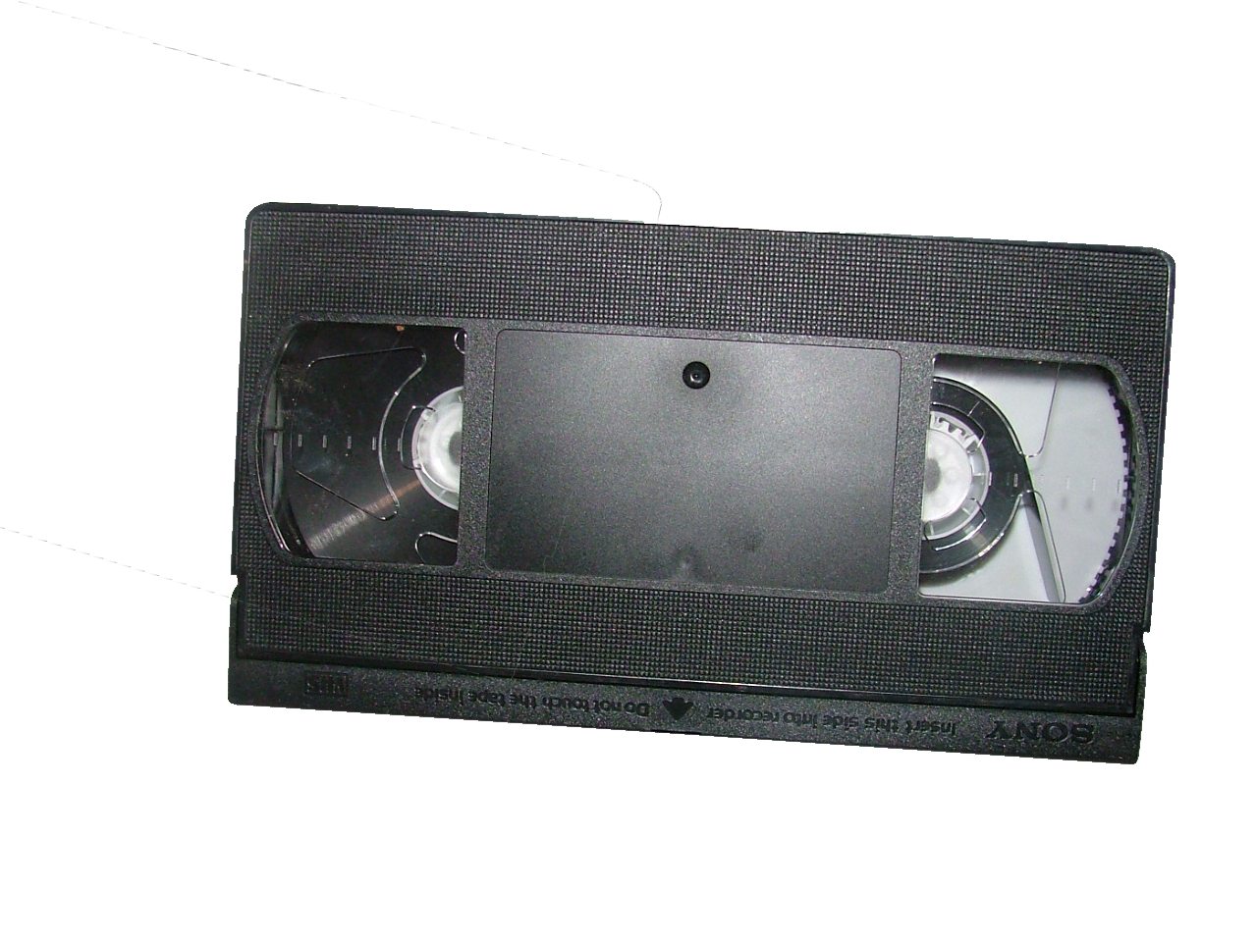
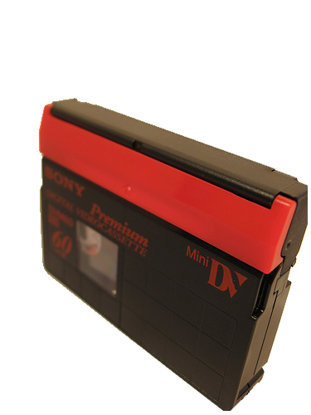
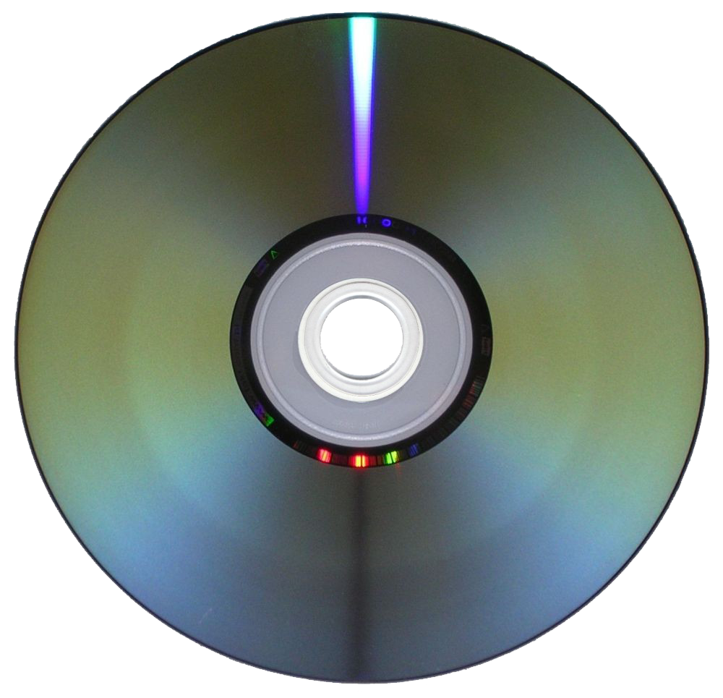
Video Formats-
VHS-
An electronic system for recording video and audio information on videocassettes.
MINI DV-
DV is a video format launched in 1996, which encodes video onto tape in digital format with intraframe compression, making it straightforward to transfer the video onto computer for editing.
DVD-
DVD (also known as "Digital Versatile Disc" or "Digital Video Disc") is a popular optical disc storage media format. Its main uses are video and data storage. Most DVDs are of the same dimensions as compact discs (CDs) but store more than six times as much data.

Slide 13
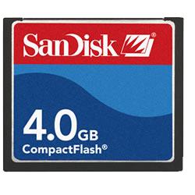
Memory Card vs. Tape-
Tape-
Pro- Hard copy of footage.
Con-This format is very expensive.
Flash Memory Card-
Pro-Saves money. The cost of tape is expensive.
Con-You have to back up the footage because its saved on a flash card.

Slide 14
VTR STATIONS

Slide 15
Tape Media

Slide 16
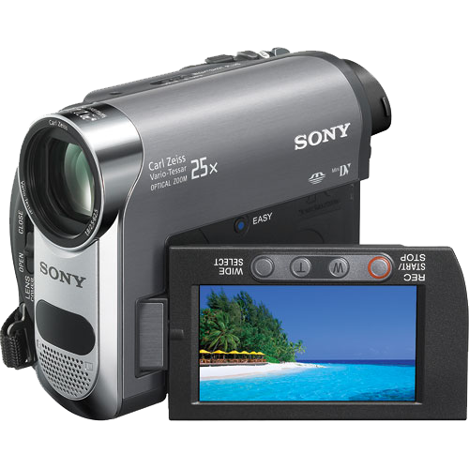
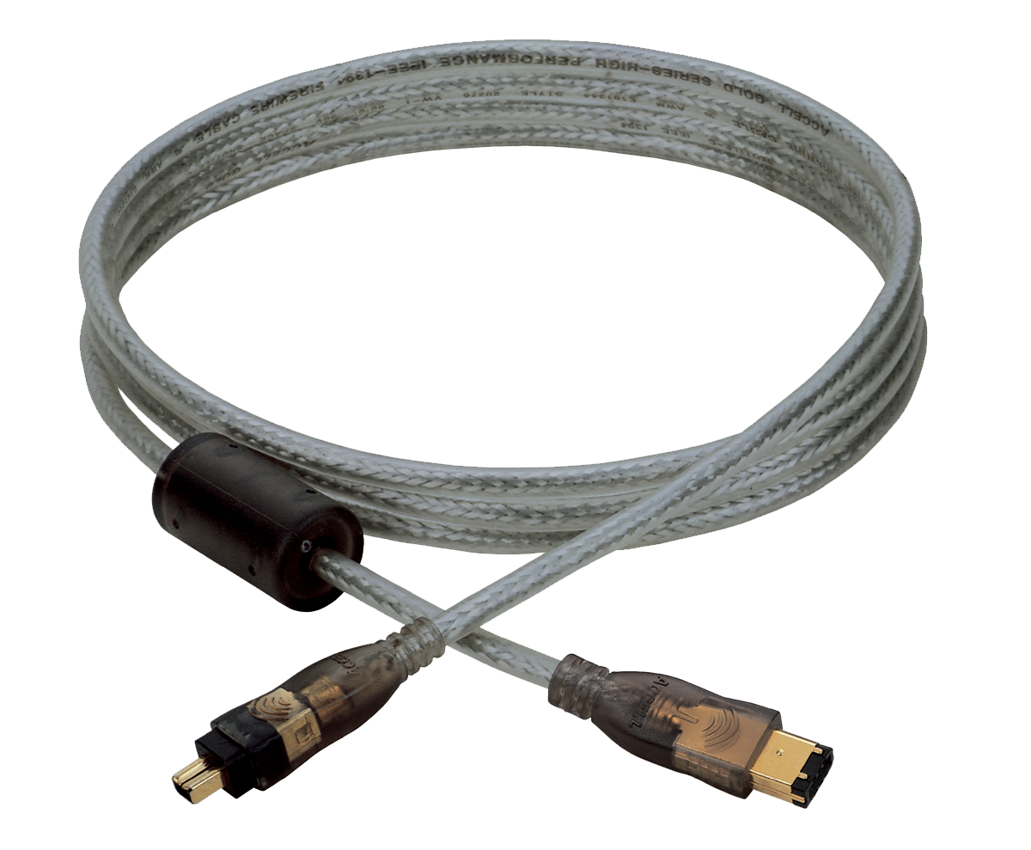
Capturing from a DV camera-
FIRE WIRE-
The IEEE 1394 interface is a serial bus interface standard for high-speed communications and isochronous real-time data transfer, frequently used by personal computers, as well as in digital audio, digital video, automotive, and aeronautics applications.

Slide 17
Importing from a Memory Card-
MPEG Streamclip is a powerful free video converter, player, editor for Mac and Windows. It can play many movie files, not only MPEGs; it can convert MPEG files between muxed/demuxed formats for authoring; it can encode movies to many formats, including iPod; it can cut, trim and join movies.
You can use MPEG Streamclip to open and play most movie formats including MPEG files or transport streams; edit them with Cut, Copy, Paste, and Trim; set In/Out points and convert them into muxed or demuxed files, or export them to QuickTime, AVI, DV and MPEG-4 files with more than professional quality, so you can easily import them in a DVD authoring tool, and use them with many other applications or devices. Supported input formats: MPEG, VOB, PS, M2P, MOD, VRO, DAT, MOV, DV, AVI, MP4, TS, M2T, MMV, REC, VID, AVR, M2V, M1V, MPV, AIFF, M1A, MP2, MPA, AC3, ...

Slide 18
Shot Composition- Review
Wide Shot-
Medium Shot-
Close Up-
Extreme Close Up-

Slide 19
Basic Functions of a camcorder.
Zoom – In and Out. The process of using the automatic zoom mechanism on the camera to bring the subject closer or further away.
Iris-Adjustable lens-opening mechanism, same as lens diaphragm. This part of the camera’s lens allows light into the camera. Pressing (+) opens the iris, pressing (-) closes the iris.
White Balance-An internal function of the video camera that balances it’s colors using a reference of all colors combined (white).

Slide 20
Basic Functions of a camcorder.
Focus-The degree to which light rays coming from the same part of an object through different parts of the lens reconverge at the same point on the film (or imaging) frame (or plane), creating sharp lines and distinct textures.
Record-The process whereby the audio and/or video electronic signal is used to arrange iron-oxide particles on the magnetic recording tape to store a record of the electronic signal for later retrieval.

