Slide 1
Chapter 20
Presentation Effects
© 2013 Cengage Learning. All Rights Reserved. May not be scanned, copied or duplicated, or posted to a publicly accessible website, in whole or in part.

Slide 2
Lessons
Lesson 20.1 Special Effects
Lesson 20.2 Animation
Lesson 20.3 Audio

Slide 3
Learning Outcomes
20.1 Use action buttons and slide transitions in presentations
20.2 Effectively incorporate animation styles, text animation, and motion paths in presentations
20.3 Enhance transitions and animations in presentations with audio

Slide 4
Special Effects
Special effects can be used to enhance your message
You can incorporate special effects during slide transitions (the point in a presentation where one slide closes and the next slide opens on the screen)
You can use a variety of special effects to animate (the application of visual effects to individual items on a slide, such as text or an image) text or images

Slide 5
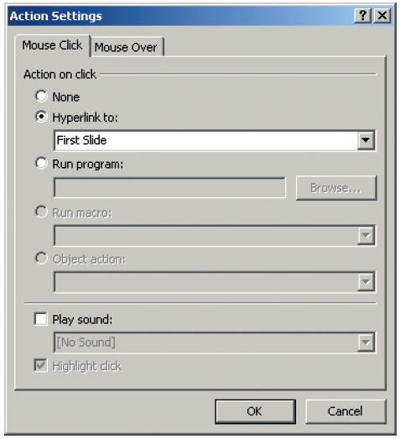
Action Buttons
Action Buttons allow you to quickly place pre-designed functions for various actions on a slide
An easy way to add interactivity to a presentation
Action buttons are used to trigger a variety of functions, such as:
Moving to a specific slide
Opening a different program
Playing an audio clip
An action can be triggered by:
Clicking on a button
Hovering over a button with your cursor

Slide 6
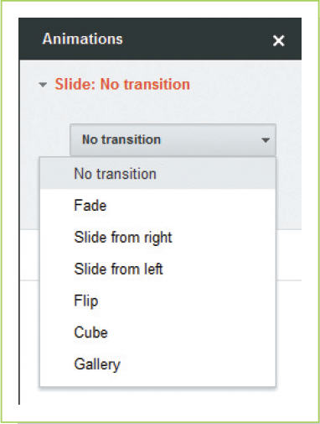
Slide Transitions
Slide transition describes the movement from one slide to another and also any effects that are used during that transition
The movement between slides can occur:
On a mouse click
After a set period of time
Transitions can also be set to:
Occur with a special sound
Last for a specific amount of time
Occur between all slides

Slide 7
Slide Transitions (continued)
Ask these questions before incorporating a special effect in a presentation:
Will this effect help clarify the message?
Will it make the presentation more effective?
Usually best to pick one subtle transition and stick with it

Slide 8
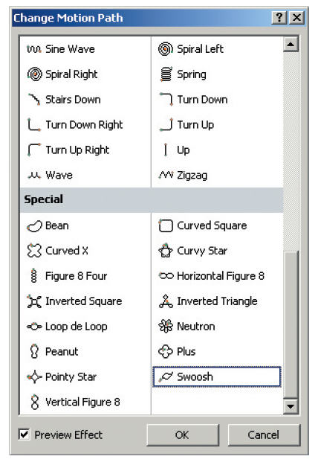
Animation Styles
An animation style is a pre-designed animated option that you can apply to text and images on a slide
You can use the styles as they are designed, or you can modify them
More unusual and less commonly used animation effects, such as unique motion paths, can also be added to images and text
Check the timing and the sequence of all animations prior to giving a presentation

Slide 9
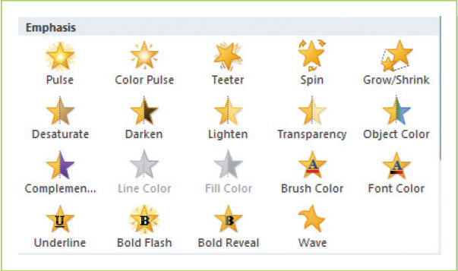
Text Animation
Text animation can be set to appear:
All at once
By word
By letter
The color and style of text can also be animated to add emphasis
Text animation can be quite effective because it keeps your audience focused on the particular point you are making, while the previous points lose impact

Slide 10
Motion Paths
A motion path is the track that animated text or image will follow as it appears on a slide; it can be a simple straight line or a more complicated one with a series of twists or turns
Can be an effective as a means of grabbing attention

Slide 11
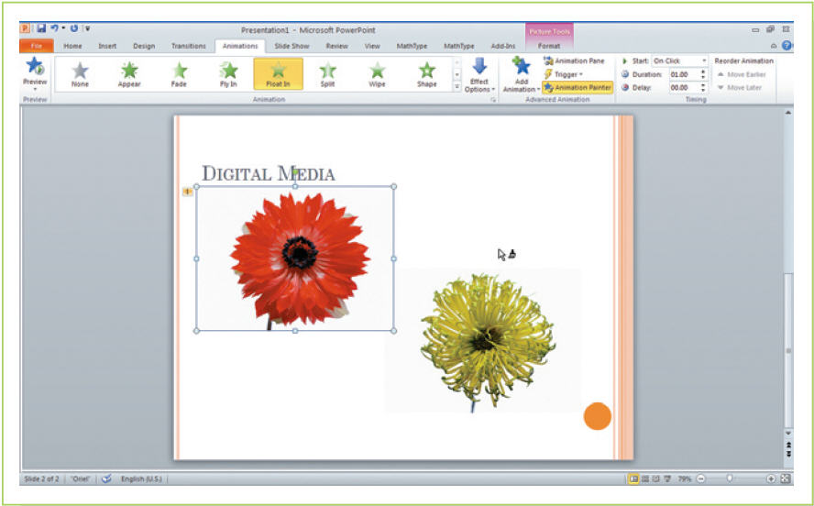
Animation Painter
You can copy animation features from one object to another using the Animation Painter tool
A time-saving tool when enhancing a presentation with animated effects

Slide 12
Audio in Transitions and Animations
An option available to you in both slide transitions and animation is audio/sound
Sound can be a significant enhancement:
A few bars of music can set the mood or tone of a presentation
Splashes of sound effects as an animation occurs can draw additional attention to the visual effect
Voice can be used to convey information
Short clips of someone else’s ideas or thoughts can be a good way to add credibility to your own ideas
You can use built in sounds or sounds you or someone else created
Can add audio to a presentation slide in two ways:
Insert it (a speaker icon appears on the slide)
Attach audio to an image or text box by using the effects options so that the sound plays as the image or text appears on the slide

Slide 13
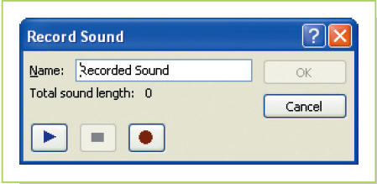
Recording Sound
In PowerPoint, you can record sound directly from within the program
Be careful with the use of audio clips provided as part of the software package; sounds that have been used before have the potential to be even less appealing to your audience than reused clip art or templates
Annoying sounds should be avoided; sounds that are interesting in the first few seconds can quickly become irritating

Slide 14
Fair Use of Music in Presentations
The fair use rules that apply to schools allow you to use up to 30 seconds of such sound in a school presentation.
This same law of fair use does not, however, cross over into commercial use
You must seek permission to use
Can purchase royalty-free music

Slide 15
Key Concepts
Presentation software programs provide several special effect options which presenters commonly use during slide transitions
Tools such as animation styles, text animation, motion paths, and the Animation Painter can, when used properly, help keep your audience’s attention
Audio can be used in both transitions and animations to set the mood for a presentation

