Slide 1
Chapter 15
Web Animation
© 2013 Cengage Learning. All Rights Reserved. May not be scanned, copied or duplicated, or posted to a publicly accessible website, in whole or in part.

Slide 2
Lessons
Lesson 15.1 Animated GIFs
Lesson 15.2 DHTML, JavaScript, and ASP.NET
Lesson 15.3 Flash Animation

Slide 3
Learning Outcomes
15.1 Outline the benefits and problems involved in Web animation
15.2 Explain the steps in making animated GIFs
15.3 Identify the advantages and disadvantages of DHTML
15.4 Describe the uses of JavaScript
15.5 Explain the difference between Flash and flash
15.6 Explain the steps in making animated flash

Slide 4
Animated GIFs
Animations display of a series of images in quick succession to show movement; they can serve several purposes
Get the attention of site visitors
Demonstrate how a product looks and its features
Use animations carefully; ask:
Does it fit?
Is it used in the right place?
Does the visitor want animation?

Slide 5
Animated GIFs (continued)
Five types of Web animation (not including imported video):
Animated GIFs
Dynamic HTML
JavaScript
ASP.NET
Plug-ins (Flash plug-ins are the most popular)

Slide 6
What Web Animation Works Well?
What kinds of animation appeal to you or seem particularly effective?
Why do they work?
What examples of animation interfere with your use of a Web page?
Why don’t you like them or think they are effective?

Slide 7
Creating Animated GIFs
Animated GIFs are created when bitmap graphics are joined into a single file to give them the appearance of motion
You can insert animated GIFs into your Web page as you would any other graphic
Can be easily create; wide variety of software options from which to choose
A frame is an individual image that makes up an animated GIF file
When an animation is played, it cycles through each frame, making it appear that a single image is moving

Slide 8
Creating Animated GIFs (continued)
Enhancements: Tweening
Tweening is the process of making a gradual change in an image by the computer rather than by the user
You can tween motion, color, or position
Banner and Other Effects
Simple to create a banner with animated display text; choose the font, text color, type size, etc.
Effects include such movements as scrolling left, right, up, or down, zooming in or out, rotating while zooming, fading, and dropping down through the bottom of the banner

Slide 9
Advantages and Disadvantages of Animated GIFs
Advantage of animated GIFs is that they are easy to create
Animated GIFs have disadvantages:
They do not have an extensive color palette; GIFs can only show 256 colors
File sizes can become quite large
Three ways to keep animated GIF file sizes small:
Create your animation on a small canvas
Have as few frames as possible
Use as few colors as possible

Slide 10
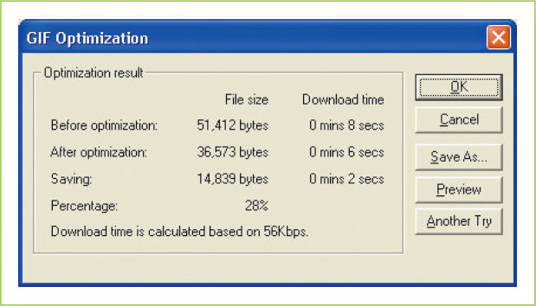
Creating Animated GIFs (continued)
Optimization is a means of compressing animations to reduce the size of the file; gives choices for:
Reducing the color palette
Eliminating unnecessary frames

Slide 11
Saving and Exporting Animated GIFs
A GIF animator will allow you to save files in several different formats:
GIF files
JPEGs or other editable raster files
Videos
You can embed the GIF file in your Web page
Another approach is to
Load the animated GIF to a server with its own URL
Insert into the Web page the <img src> HTML tag that links to that document; the code identifies the animated GIF file as the source of the image

Slide 12
Dynamic HTML
Dynamic HTML (DHTML) is a means of animating text or image elements through the HTML code that determines their placement and appearance
Advantage of DHTML is that it does not include an image:
Does not require a large file size
Loads as quickly as any HTML file
Disadvantages:
Like HTML itself, its instructions will not necessarily be interpreted the same by all browsers
It cannot be used to create very complex animations
It is not really a standalone tool; it is a creation of three other tools—HTML code, CSS, and JavaScript

Slide 13
JavaScript
JavaScript is a programming language that increases the interactivity of Web pages by making it possible for actions to be executed within the browser, and without the need to access the server that hosts the Web site
An applet is an executable program that cannot stand alone but functions only within a Web browser
Uses and Elements of JavaScript
Scripts can be written to change the content or appearance of the Web page when users move their mouse or make a choice
Can be used to perform searches, create pop-up windows, or fill out parts of a form

Slide 14
JavaScript (continued)
Uses and Elements of JavaScript (cont.)
JavaScript applet is signaled by the <script> code; its end is shown by the </script> code
Commands are case-sensitive
Values should be in quotation marks
You can group together a set of statements in curly brackets—{ and }
JavaScript includes different kinds of tools
Objects (Unit manipulated in JavaScript, which has both properties and methods)
Functions (JavaScript command not executed until an event occurs)and events (an action taken by a Web site visitor that triggers execution of a script)
Conditional statement (an action taken if certain conditions are or are not met)

Slide 15
JavaScript (continued)
Examples of JavaScript
You can create a rollover, in which mousing over an image results in a change to the image, which returns to its original state when the mouse moves off it again
Can use this effect to change the appearance of a word by altering its size or color,
Can also use it to swap one image for another
Can create a dialog box

Slide 16
ASP.NET Scripts
ASP.NET is Microsoft’s server-side scripting language
ASP is an acronym for Active Server Pages
The Web editor Expression is a Microsoft product that relies on ASP.NET programming to create animations and interactive elements on Web pages
ASP.NET and JavaScript can complement each other
Either kind of script can work within DHTML code

Slide 17
Thinking Visually
How can visuals be used?
In what way could a company use visuals to market its services?
What story can visuals tell to potential customers?

Slide 18
Flash Animation
A popular form of animation is a shockwave flash file (SWF) created with Adobe Flash Professional or similar programs
A plug-in is a small piece of software downloaded into a browser to run specialized types of files
In the case of flash programs, the files they run are multimedia
The plug-ins are written to be relatively small in size, though versatile, so that download times are not long
One thing that makes plug-in animation players different from video players is that they permit—and respond to—user input; they can be interactive

Slide 19
The Appeal of Flash Animation
Flash animations promote quick download times
Vector-based graphics define the beginning and ending points of objects mathematically, thus the image is easier to resize or scale than raster images such as photographs and the result is smaller file sizes
Vector-based programs, like flash animation software, define the tween frames by calculating them mathematically; these calculations occupy less space than a raster-drawn image filled with color dots
Flash animations are streamed, meaning that it begins to play before the entire file is downloaded
Flash animation is widely available and easy to use

Slide 20
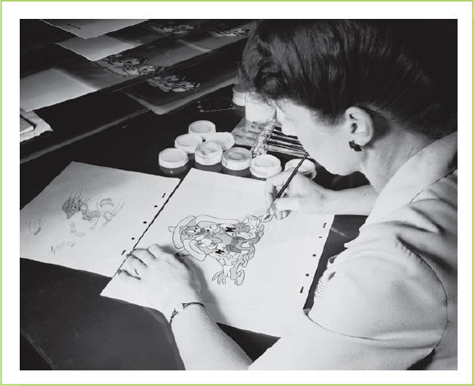
Frames and Key Frames in Flash
Flash is essentially a digitized version of cel animation (the use of transparent pages to create a sense of movement)
The essential tool used to create and control flash animation is a timeline that records when each event will occur and what actions will happen
A keyframe sets the point at which each new action begins
©Hulton-Deutsch Collection/CORBIS

Slide 21
Frames and Key Frames in Flash (continued)
The area where the animation comes together is called the stage
The timeline, includes a counter, the layers, frames, and keyframes
The frames per second indicates the rate at which each frame is displayed
Looping refers to the repetition of a series of frames that can be used to add length without increasing the file size

Slide 22
Creating Flash Animation
Two ways of creating animation in Adobe Flash Professional:
Import images created in another program
Use the software’s own drawing tools
Importing Art into Flash
Add it directly to the stage
Add it to the library (a collection of all the elements that go into a Flash file)
Animations can be further enhanced by adding photographs, video captures, text, and even music

Slide 23
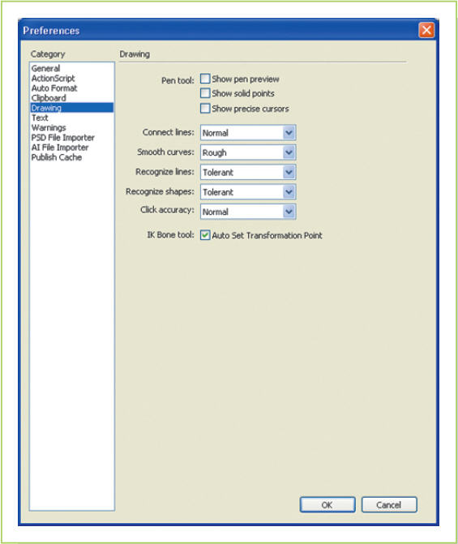
Creating Flash Animation (continued)
Drawing in Flash
Flash has a range of drawing tools that allows you to draw right in the program itself
Tools include: Pen tool, Text tool, Line tool, Rectangle tool, Pencil tool, Brush tool, and Deco tool
Flash Professional provides the perfecting mechanism

Slide 24
Creating Flash Animation (continued)
Modifying Images
Flash provides various tools for manipulating and transforming images and other objects within an animation
Two simple changes: modifying the size and Skewing (rotating) an object
Many other ways of transforming objects (changing an image such as making it larger or applying a different color)
A path animation is the path along which an animation sequence moves (may include rotating, flipping, or changing direction or color)

Slide 25
Creating Flash Animation (continued)
Modifying Images (cont.)
Bitmap graphics can be added to shockwave files, and they too can be transformed
The size or shape can be distorted, which is called warping
If the image transforms from one shape into something completely different, that is morphing
Many of these effects can be used on text as well

Slide 26
Saving Flash Animation Files
Default is to save in the .fla native format
You can preview your animation as you work
You can choose to export the file as an image or a movie and choose among several different formats, including:
The traditional .swf flash file format
Animated GIF
QuickTime movie
Windows movie
The best option is to publish the animation using the Publish option in the File menu
Saves the animated clip in the desired format
Writes the HTML coded needed to place in a Web site

Slide 27
Key Concepts
Web animations are used to attract customers, demonstrate products, and introduce special offers; they need to be used carefully, though, to make sure that they fit the purpose and tone of the Web page
Animated GIFs are simple Web animations based on graphics created in raster-based graphics programs; GIF animation programs combine individual images called frames and use the process called tweening to insert additional frames, in order to reduce the amount of time needed to create constituent images
Animated GIFs are easy to create, but they tend to have very large file sizes, which can slow download times; file sizes can be reduced through various techniques, including optimization

Slide 28
Key Concepts (continued)
Dynamic HTML is a technique that manipulates underlying HTML code to change the way information is displayed on the Web or to create interactive environments for users; it has less visual capability than other forms of animation, however
JavaScript is a scripting language that sits within HTML to create opportunities for user interactions; because the scripts run through the browser, they do not slow download times; it is a very flexible and useful tool for interactions, but not as visual as GIF animations or flash animation
ASP.NET is another scripting language, but one that works on the server side rather than at the client, or browser, side; like JavaScript, it is more effective for interactions than animations

Slide 29
Key Concepts (continued)
Flash animation is a vector-based approach to animation that has relatively small sizes for animations, is highly flexible, and extremely popular; viewing flash animation requires browsers to download a flash reader, a free plug-in program
Flash animation programs allow creators to import art or create art within the program itself. Images can be combined and manipulated on a timeline; like other illustration programs, flash animation relies on layers, each of which can contain text or art, and all text and art objects can be treated with special effects
To create flash animation, you place words, images, or objects on separate layers and manipulate the keyframes, which signal the start of each layer, onto successive points on the animation timeline; the duration of any element on the timeline can be extended by adding frames to it; Flash animators write HTML code that is automatically inserted into Web documents when the animation is imported

