Slide 1
Chapter 14
Web Design
© 2013 Cengage Learning. All Rights Reserved. May not be scanned, copied or duplicated, or posted to a publicly accessible website, in whole or in part.

Slide 2
Lessons
Lesson 14.1 Planning Content and Navigation
Lesson 14.2 Setting the Look of the Page
Lesson 14.3 Designing Page Elements
Lesson 14.4 Selecting and Incorporating Images

Slide 3
Learning Outcomes
14.1 Explain the importance of content in Web design
14.2 Plan a Web site with navigation links
14.3 Describe the differences between designing for the Web and for print
14.4 Plan the look of Web pages
14.5 Use templates and style sheets to achieve consistent design
14.6 Select and incorporate images in Web pages

Slide 4
Planning Content
A Web site is one or more Web pages linked together in an organized collection
When designing a Web site keep in mind that the most essential element of any Web site is the content
First Things First
First, consider the goal of the site

Slide 5
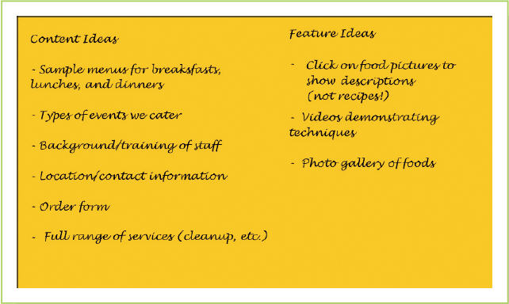
Planning Content (continued)
First Things First
First, consider the goal of the site; ask:
Who is the audience for the Web site?
What product or service does the site make available to this audience?
Begin designing a site by jotting down initial ideas on content and features

Slide 6
Planning Content (continued)
Outlining the Site
Storyboarding is the process of creating a series of sketches indicating the content and links that connect one Web page to another
Another way of planning the structure of the site is to use a graphic that shows the hierarchy of pages within the site
The home page is the main page of a Web site, which is generally the first page visitors will see
A navigation link is a means of guiding a visitor to a Web site from one page in the site to other pages

Slide 7
Planning Content (continued)
Supplementing the Navigation Links
Web sites typically include a search function and a site map
A search function lets visitors try to find specific information on a Web site
A site map is a single Web page that lists and organizes all the Web pages in a site
A hyperlink is a text or an object that links to another Web page

Slide 8
What Works for You?
One of the best ways to find effective ways of organizing Web content is to browse the Web
As you go about your everyday Web use, think about what you like and don’t like about each Web site you visit
Think about how you can apply those principles and practices to your own sites

Slide 9
Creating Content
Web content should always be focused and concise
Drafting the Text
Remember your audience
Provide information as briefly and effectively as possible
Keep text concise on the opening pages; place pages with more text deeper in the page structure
Make sure that each page focuses on one major topic

Slide 10
Creating Content (continued)
Polishing the Text
Edit text so it is well organized and clear
Think of what your audience wants to know and whether the text provides that information
Think about what background on the topic your audience might not have and explain any points that need clarification

Slide 11
Getting Approval
The client has the final say on:
What should be in the Web site
How the Web site should be structured
How visitors will navigate within the Web site
At each stage in the design process, get the client’s approval of the approach you suggest
Show the storyboard or overall organization before beginning to work with content
If you are writing the content, show it to the person with the authority to approve the site in draft stage and after it has been polished

Slide 12
Organizing and Naming Web Site Files
Create a separate file for each Web page
Conventions for naming Web files
Use lowercase letters only
Include no spaces but use hyphens or underscores between words
Use keywords that describe the content on each page in the file name for that page
Limit URLs to a maximum of 60 characters
Be sure to create an index page (home page)

Slide 13
Web Design Versus Print Design
Web designer does not control the final appearance of the design as much as a print designer does
Web designers need to create designs that accommodate variations
Difference in the tools or design elements a designer has to work with
Difference is in the attitudes and expectations that the user brings to the product
People interact with Web and print products differently

Slide 14
Organizing Web Pages
Planning Navigation
The navigation system is the main way of providing information to your customer
A common means of navigating is a series of panels that act like a directory
Image maps are graphics divided into two or more parts, with each part assigned a different link

Slide 15
Organizing Web Pages (continued)
Organizing the Page
The top area identifies the company or group publishing the site; includes important functions or links
The bottom of a Web page:
Should repeat the navigational links
Holds the copyright information or links to a separate copyright page
Contains links to the site map
Has a link to a page for contacting the organization publishing the site
The main area of the page is where the text and graphics will be displayed

Slide 16
Organizing Web Pages (continued)
Using Tables and Layers
Tables and layers help you organize content on your Web page
Add structure and stability to the design and allow for better control of the placement of content
Cell padding is the space within a cell that separates or pads the text or image within the cell
Cell spacing is the amount of space between cells
The <div>, or division, code is a part of cascading style sheets

Slide 17
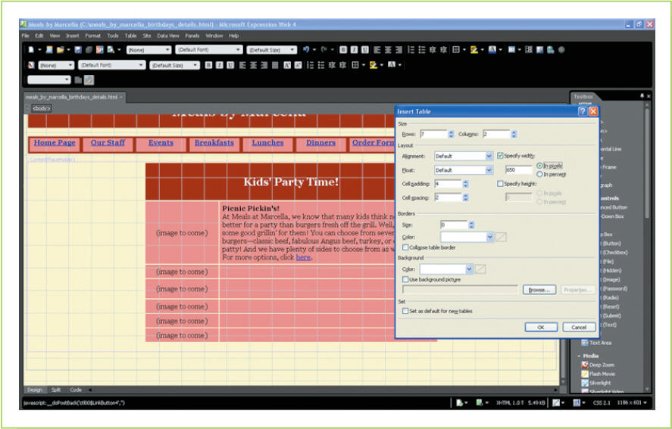
Organizing Web Pages (continued)

Slide 18
Using Templates
A template is a design file that contains the common elements that should appear on all pages; also called a master page
A template has two kinds of areas:
One type is common to all pages—these are the areas that will not change
The other type is the open area where individual page content will appear

Slide 19
Using Design Elements
A Web site should look coherent
Helps create a company identity
Visitors to the site know what to expect
Purpose of the Web site is to invite traffic; design elements that do not meet that goal are not necessary
Whenever choosing design elements, bear readability in mind
Colors and graphics add to the load time; the longer the load time, the higher the likelihood that visitors will surf away from the site

Slide 20
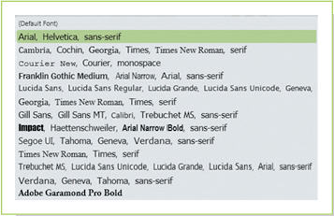
Using Design Elements (continued)
Fonts
Best to specify font options so that each visitor’s browser can display the text using the option that it has
Font size is specified using a system of showing relative font size; the variations are all made relative to the browser’s and monitor’s default font size
Cascading style sheets (CSS) include information on how a page should appear

Slide 21
Using Design Elements (continued)
Colors
Select both foreground and background colors that offer high contrast
Computer color systems can use either millions of colors 256 colors, or 16 colors
Colors are identified with a six-character code called a hexadecimal number

Slide 22
Using Design Elements (continued)
Other Design Elements for Web Pages
Interactive elements include:
Login input boxes
Radio button choice boxes
Boxes for inputting comments or other feedback
Icons or boxes for rating a product or service
Boxes for filling out forms
Icons that open popup boxes for ordering goods or services
Other elements include icons that link to a company’s Facebook page, Twitter account, or e-mail contact

Slide 23
Saving Images for Web Pages
Image Resolution
Bitmap graphics tend to have large file sizes, which makes them take longer to download
Best to size bitmap images in a drawing or photo editing program before saving them
Maximum size for an image should be about 600 × 400
Most monitors have a resolution of 72 or 96 pixels per inch
Images should be saved at one of these resolutions
Photo editing programs typically use 72 dpi as a default

Slide 24
Saving Images for Web Pages (continued)
Compression
The higher the compression, the smaller the file size—and the lower the quality of the image
What you lose in quality, you gain in speed of uploading
For a photograph sized at 640 × 480, that amount of compression produces a file size of 104 KB
The highest compression rate brings the file size down to 68 KB
The maximum quality level puts it at 180 KB

Slide 25
Placing Images on Web Pages
Placing an Image
Web editors often automatically write the code needed to insert an image
You can format an image in relation to text and placing additional space around it
Need to label the image with alternative text (a brief description of an image that browsers display while the image is loading or if the browser cannot upload it)

Slide 26
Placing Images on Web Pages (continued)
Thumbnails
Thumbnails are small versions of larger images; they speed up the download process by allowing viewers to choose whether they want to see the larger image
Many Web editors provide thumbnail capabilities
Rollovers
A rollover is the changing of an image or text when a cursor either passes over or clicks on it
Banner ads are Web ads that often contain a logo and additional business information designed to give corporate identity to a page

Slide 27
Key Concepts
Creating a Web site begins with planning, and the first step in planning is to determine the site’s purpose and goals, which are based on its potential audience
The site should be sketched out in some way and the main sections and related subsections be determined; that structure will become the basis of the site’s organization
Like any text, the content for a Web site should be drafted, edited, and then polished

Slide 28
Key Concepts (continued)
While Web pages share some features with print pages, Web design is very different because of:
The lack of control the designer has over the look of the final product
The expectations users have on using the Internet
The possibility of interactive features
Tables can be used to structure pages, and templates can be used to create common elements on all pages while still leaving space for unique content
Creating options for fonts makes it possible to avoid display issues on different browsers; using cascading style sheets can create consistency across a Web site

Slide 29
Key Concepts (continued)
Colors are specified using hex numbers and should be selected very carefully
Bitmap graphics such as photographs should be saved to relatively small sizes and in compressed form to help pages load faster
Web editors make it easy to place and format images; some helpfully remind Web developers to add alternate text labels, needed to improve accessibility

