Slide 1
Chapter 10
Print Design
© 2013 Cengage Learning. All Rights Reserved. May not be scanned, copied or duplicated, or posted to a publicly accessible website, in whole or in part.

Slide 2
Lessons
Lesson 10.1: Understanding Design Principles
Lesson 10.2: Structuring a Layout
Lesson 10.3: Using PDFs for Print Publications

Slide 3
Learning Outcomes
10.1: Recognize basic design principles: balance, rhythm, emphasis, and unity
10.2 Understand the role of white space
10.3 Follow preliminary steps to plan a layout
10.4 Set up a new document in desktop publishing software
10.5 Use a grid to lend underlying structure to designs
10.6 Understand why PDFs are important in the print publication process

Slide 4
Understanding Design Principles
Layout is the arrangement on a page of all the key parts without regard to the specific content
A pica is a printer’s measurement equal to 1/6 of an inch
The overriding idea behind good design is the relationship between similarity and contrast
Similarity in a design is what helps a viewer navigate and recognize a design as a single unit; without similarity, a design is chaotic and the message is not clear
Contrast in a design captures, keeps, and directs a viewer’s attention; without contrast, a design can be boring and, potentially, ignored

Slide 5
Balance
Balance refers to a design principle in which the weight of elements is distributed in a visually appealing way
Balance is important because it is pleasing and restful to the eye
Unbalanced designs can leave a viewer feeling uneasy
To understand balance, consider an imaginary line dividing a layout in half; the design may be divided vertically, horizontally, or diagonally
To achieve balance, a designer must arrange the graphic elements so that all sides of the layout have the same visual weight

Slide 6
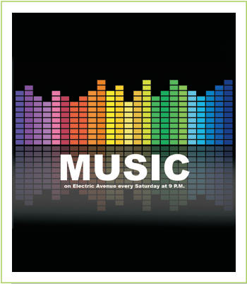
Balance (continued)
There are three types of balance:
In symmetrical balance, elements are distributed equally on both sides of the axis, sometimes even in mirror images of one another
In radial balance, all of the elements radiate out from a center point, like a starburst

Slide 7
Balance (continued)
In asymmetrical balance, the elements on either side of the imaginary axis are not equal or mirrored, but they carry the same visual weight, and, therefore, the overall visual effect is balance

Slide 8
Rhythm
Rhythm is a design principle that connects elements in a design and guides a viewer’s eye from one item to the next
Rhythm in a design normally shows up in one of three forms:
Regular: The fixed, even pattern of elements that suggests faster movement
Flowing: A softer, more subtle repetition of elements, often involving curves and rounded patterns, that suggests a slower movement
Progressive: A more rare form of repetition in which an element is depicted in various stages of progress that suggests movement through time

Slide 9
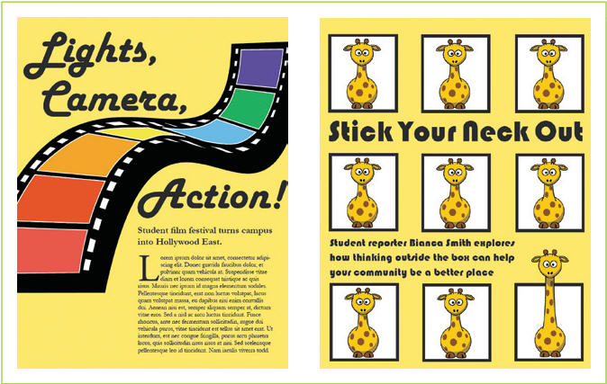
Rhythm (continued)
Do these designs incorporate rhythm?
What elements indicate the rhythm?
What could be changed to use rhythm more effectively in these examples?

Slide 10
Emphasis
Emphasis refers to a design principle in which certain elements in a design stand out more than others
There are three basic ways to establish emphasis in a design: placement, isolation, and contrast.
Designers achieve emphasis is by contrasting the properties of certain design elements:
Size
Shape
Color
Orientation

Slide 11
Unity
Unity is a design principle that pulls together all of the individual elements, making the design look like a single unit
Four general areas contribute to unity in a design:
Proximity
Alignment
Repetition or Consistency
Contrast
Notice that the pen is just slightly out of alignment. Does your eye want to straighten it?

Slide 12
White Space
The areas in which text or graphics do not appear have as much importance as the areas in which they do appear are called white space (or sometimes negative space)
White space acts as a design element
A block of white space can be used as a means of guiding the eye, as well as of resting it
White space can pose two problems:
Trapped white space is white space surrounded on all sides by text or graphics
Rivers of white are found most often when text is justified because the extra space inserted in a line can be duplicated on the line above and below

Slide 13
Structuring a Layout
Preliminary work before even launching your software:
Gather materials
Brainstorm a design theme
Choose design elements
Sketch layout ideas
After you’ve taken these steps, you should be ready to launch your software and get started with your design

Slide 14
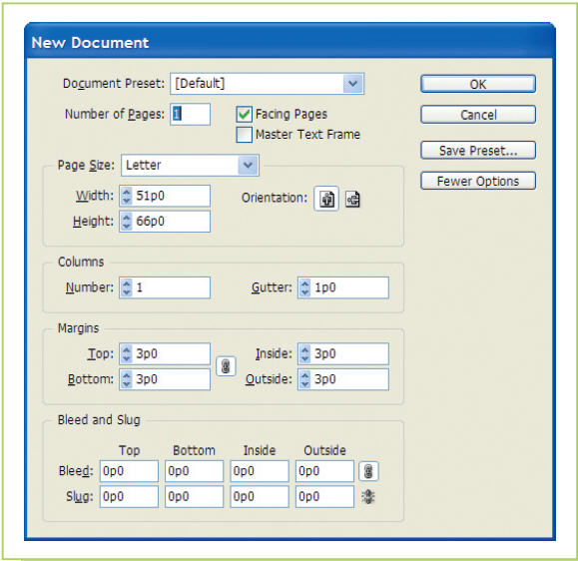
Setting Up a New Document
When you create a new document from scratch, you must specify certain page setup options that will be applied to all of the pages

Slide 15
Setting Up a New Document (continued)
Things to consider when making page setup decisions:
Facing Pages: Two side-by-side pages; also referred to as a spread
Number of Pages: Multi-page documents sent to a professional printer must be set up in even signatures
Number of Columns and Size of Gutters: Columns are nonprinting guidelines used to organize and align elements on the page; a gutter is the white space between each pair of columns.
Margins: Wide margins can make a designer cleaner, but mean less content can fit on a page or spread; narrow margins mean more content on a page, but can make a page look crowded and chaotic
Bleed: A bleed is an element that extends through the margin of a page right up to the edge

Slide 16
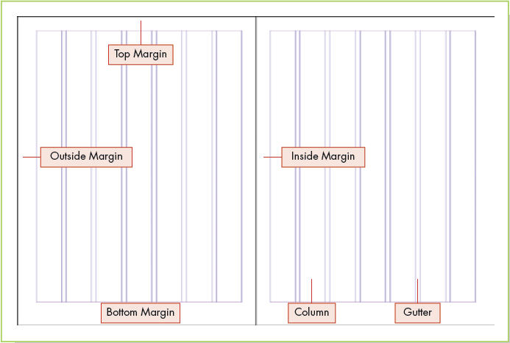
Using a Grid to Organize Elements
A grid is a series of vertical and horizontal non-printing guidelines on a layout that direct the placement and size of objects on a page
A grid can make it easier to incorporate design principles
The series of vertical grid lines in a layout are referred to as columns

Slide 17
Using a Grid to Organize Elements (continued)
The appropriate number of columns for a design will depend on the size of the page and the complexity of the design
General guidelines for determining the number of columns for a project:
Two-column grids are useful for narrow pages and simple designs, as long as the column width does not make text line length too wide for comfortable reading
Three-column grids are more flexible since items can span one, two, or all three columns, and three-column layouts work for almost all page sizes
Four or more columns are usually the most flexible choice for page structure; odd numbers of columns seem to work best in a design because they allow you to build asymmetry

Slide 18
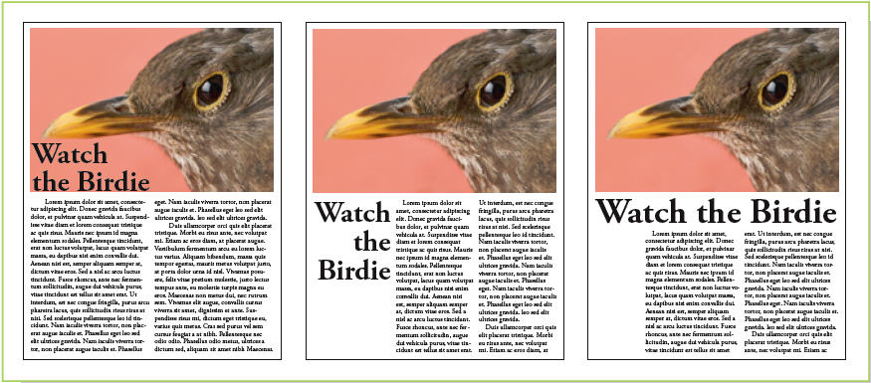
Using a Grid to Organize Elements (continued)
You can add variety to a two-column grid by having some elements span both columns
Three-column designs are relatively simple
Can you see the underlying column structure?

Slide 19
Using a Grid to Organize Elements (continued)
The vertical alignment of elements is the most important concern in design
Horizontal alignment is determined by how big an element is after you size it to fit the vertical columns
Vertical and horizontal alignment is important for establishing order in a design, but just as important is occasionally breaking the order to create interest
The overriding rule when breaking the grid is to do it for a specific reason: to achieve unity, balance, emphasis, or rhythm

Slide 20
Master Pages and Templates
Master pages are page designs that can be applied automatically to any page within a document
Usually include elements that are repeated on multiple pages, such as headers or footers, or logos
Can contain a basic structure that will be repeated on multiple pages such as columns or standardized text frames
Are useful shortcuts for standardizing designs across a book series or any document series that share common elements
Master pages are often incorporated into templates

Slide 21
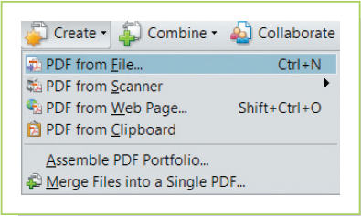
Creating and Viewing PDFs
You will most likely generate PDFs directly from within your layout program
There are two basic tasks associated with PDFs: creating PDFs and viewing them
Some PDF software can both create and display PDFs
Other software can display PDFs, but cannot create them

Slide 22
PDFs and Print Production
When you send a PDF of your document to a printer, you can be confident that what you saw in the PDF is what will come off the press
You can create a PDF for the press from almost any application
It’s best to create PDFs using settings verified or supplied by the print vendor
PDF/X minimizes the chance of problems once your PDFs reach the press

Slide 23
Employees Taking Initiative at Work
Probably the best way you can advance your career is to take initiative at work
One way to take initiative is to find small ways of improving how a job is done
Determine your employer’s wants and needs, then find the best possible way to meet them
How can you take initiative in your work or your classroom?

Slide 24
Key Concepts
An overriding idea behind good design is the tension between similarity and contrast:
Without similarity, a design is chaotic and unreadable
Without contrast, a design is boring and forgettable
Balance is the design principle that says the weight of objects is evenly distributed across a design
In symmetrical balance, elements are distributed equally on both sides of the axis, sometimes even in mirror images of one another
In asymmetrical balance, the elements on either side of the imaginary axis are not equal or mirrored, but they carry the same visual weight

Slide 25
Key Concepts (continued)
Rhythm refers to how a viewer’s eye travels through a design and is often established through repetition of a design element or sequence
Emphasis relates to the center of interest in a design and establishes a visual hierarchy that leads a viewer through a layout; it is often established through placement, isolation, and/or contrast of design elements
Unity in a design means that all of the individual elements of a design look like they belong together and causes the reader to recognize the design as a whole before noticing its individual parts
Proximity, alignment, and repetition (especially in alignment and structure) contribute to unity in a design

Slide 26
Key Concepts (continued)
Using a grid reduces the randomness of deciding where to place items on a blank page and how big to make them
The grid is important for establishing order in a design, but just as important is occasionally breaking the order to create interest
Master pages and templates are shortcuts for creating consistent documents that share a similar design and features
PDFs are well suited for the print publication process because they retain all of the data about fonts, graphics, color, and so on from the native application file and minimize issues on the press

